Slide 1
214A Project Presentation
Yuhang Li, Yuheng He, Zilin Zeng

Slide 2
Table of Contents
Feature Extraction
Feature Set 1
Feature Set 2
Result Analysis
Clean Test
Noisy Test
Future Work

Slide 3

Feature Set 1 - MFCC
A compact representation provided by a set of Mel-frequency Cepstral Coefficients (MFCC)
a cosine transform of the real logarithm of the short-term energy spectrum expressed on a mel-frequency scale
Selected 13 features (out of 39)
amplitude of frequencies (first 12)
the energy in each frame (13)

Slide 4
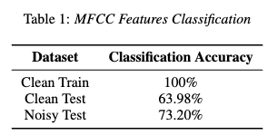
Feature Set 1 - MFCC
Surprising result

Slide 5
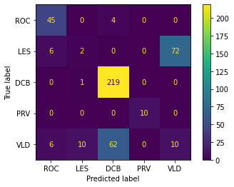
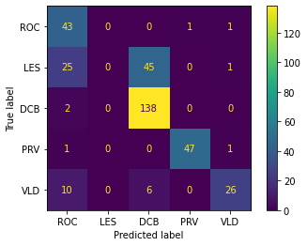
Feature Set 1 - MFCC
Confusion Matrix for Clean Test and Noisy Text
Clean
Noisy

Slide 6
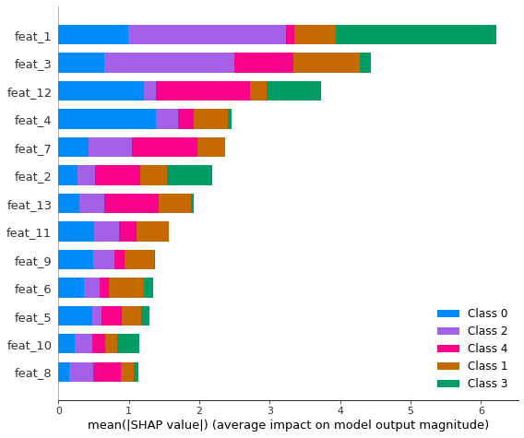
Feature Set 1 - MFCC
Explained Features
Some features are more important than others

Slide 7
Feature Set 2 - LPC
Vocal Tract Envelope!
Formant Frequency Estimations
P=48
Averaged LPC coefficients for every 40 sec window

Slide 8
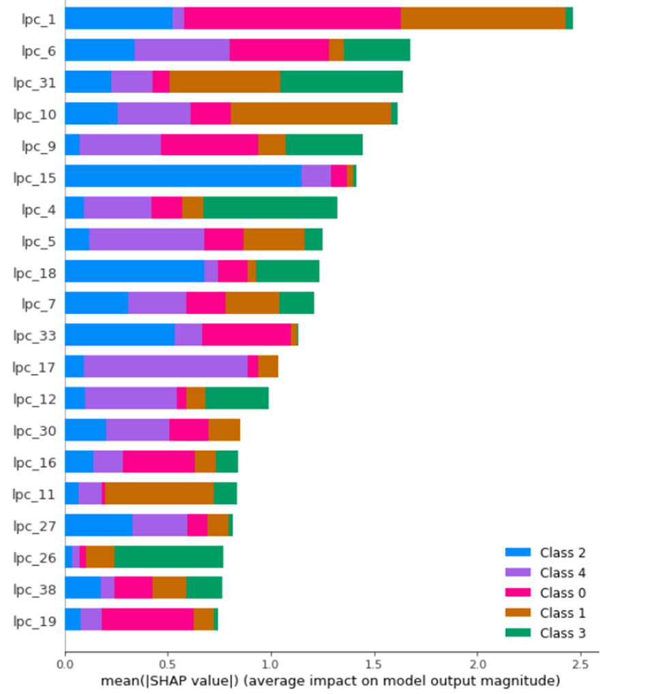
Feature Set 2 - LPC
High Order P Plays a Role

Slide 9
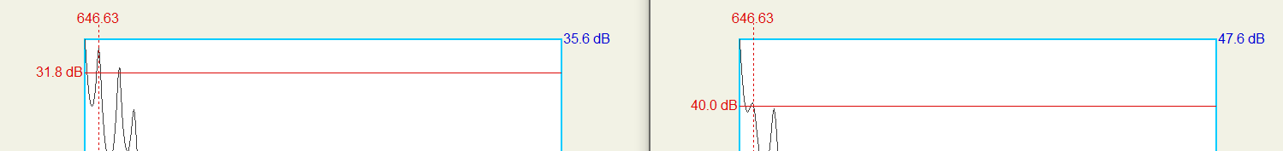
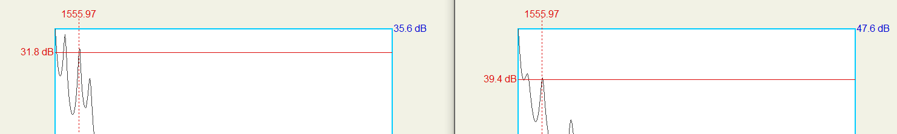
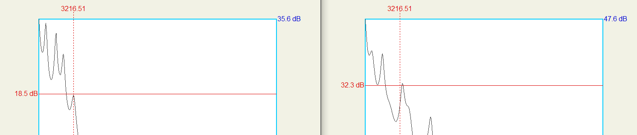
Feature Set 2 - LPC
Train
Test
Clean
Noisy

Slide 10
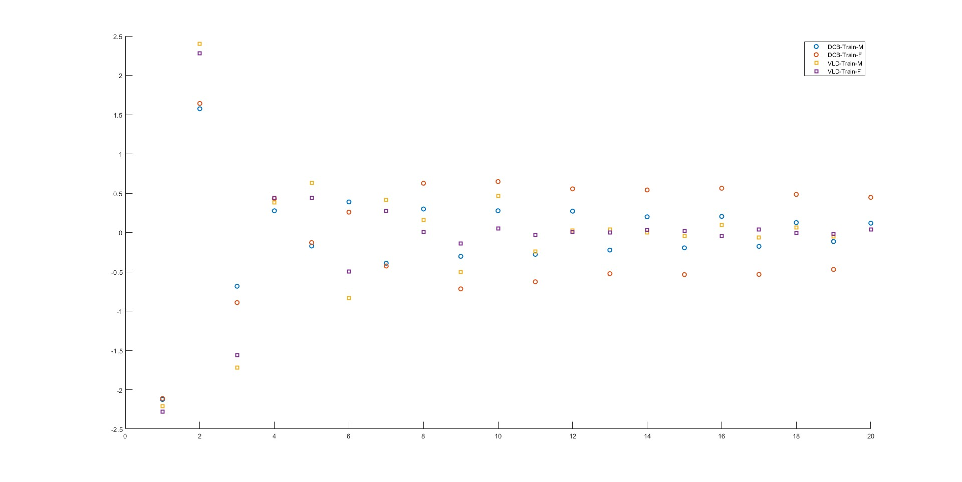

Slide 11
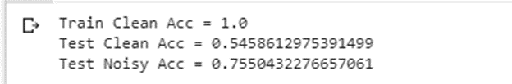
Feature Set 2 - LPC
Noisy Better than Clean???
Accuracy for Clean Test and Noisy Text

Slide 12
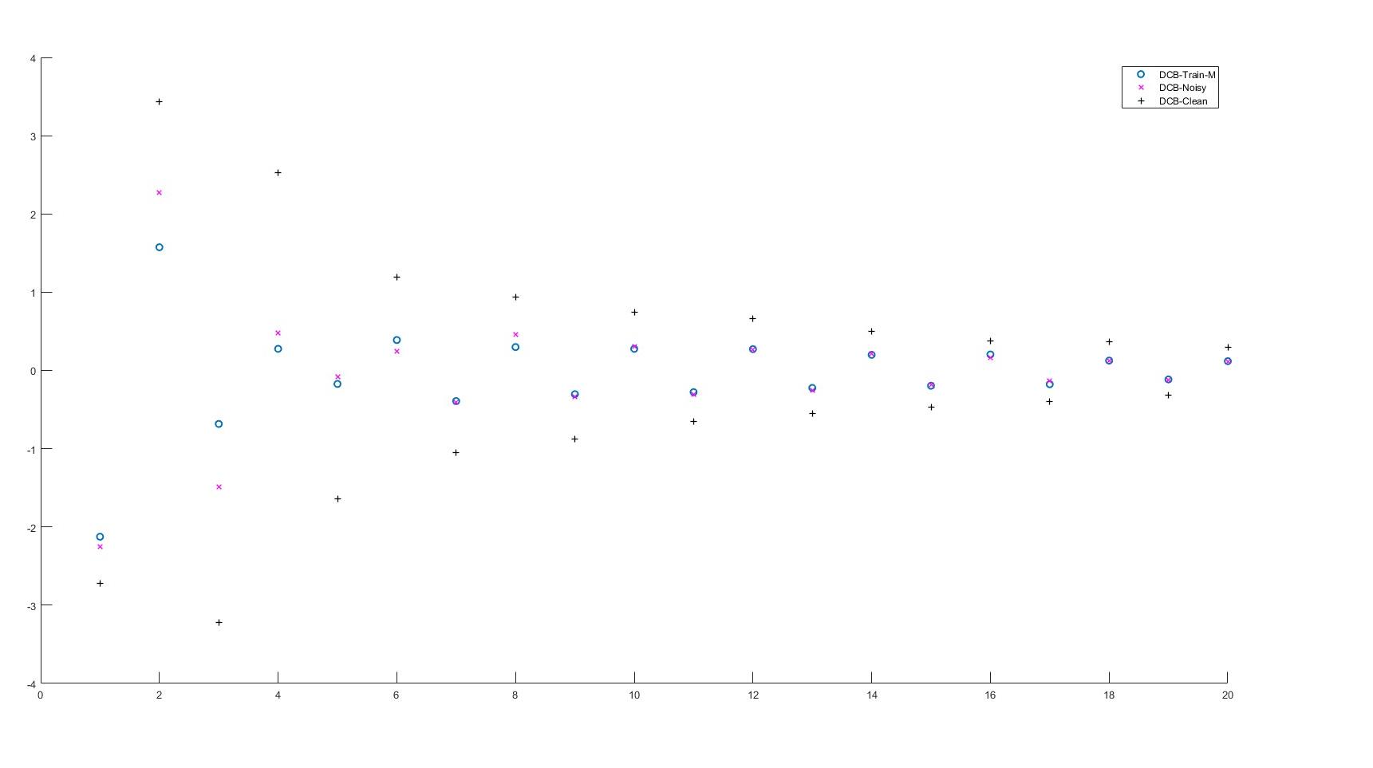

Slide 13
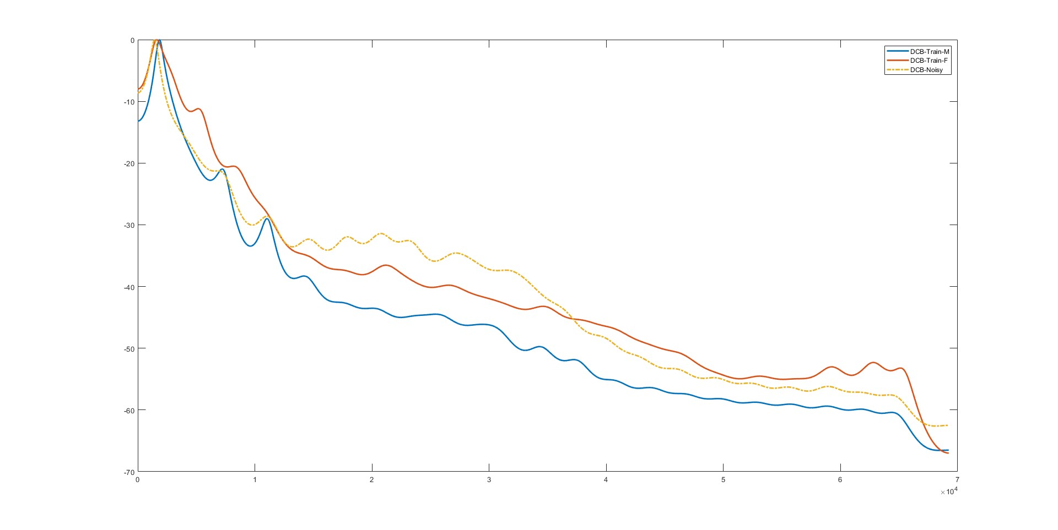

Slide 14
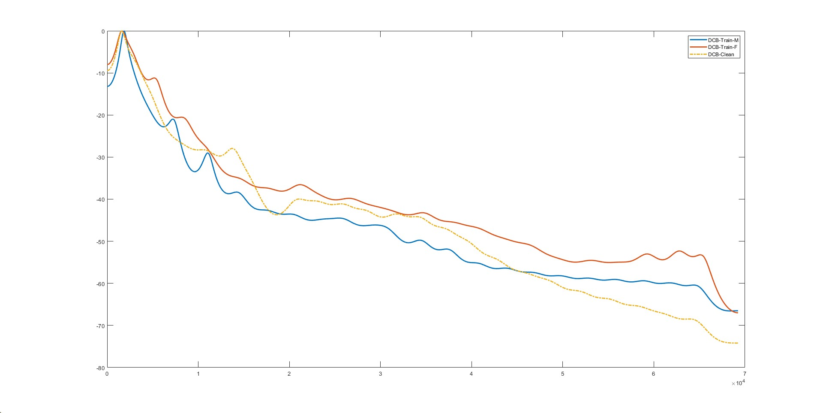

Slide 15
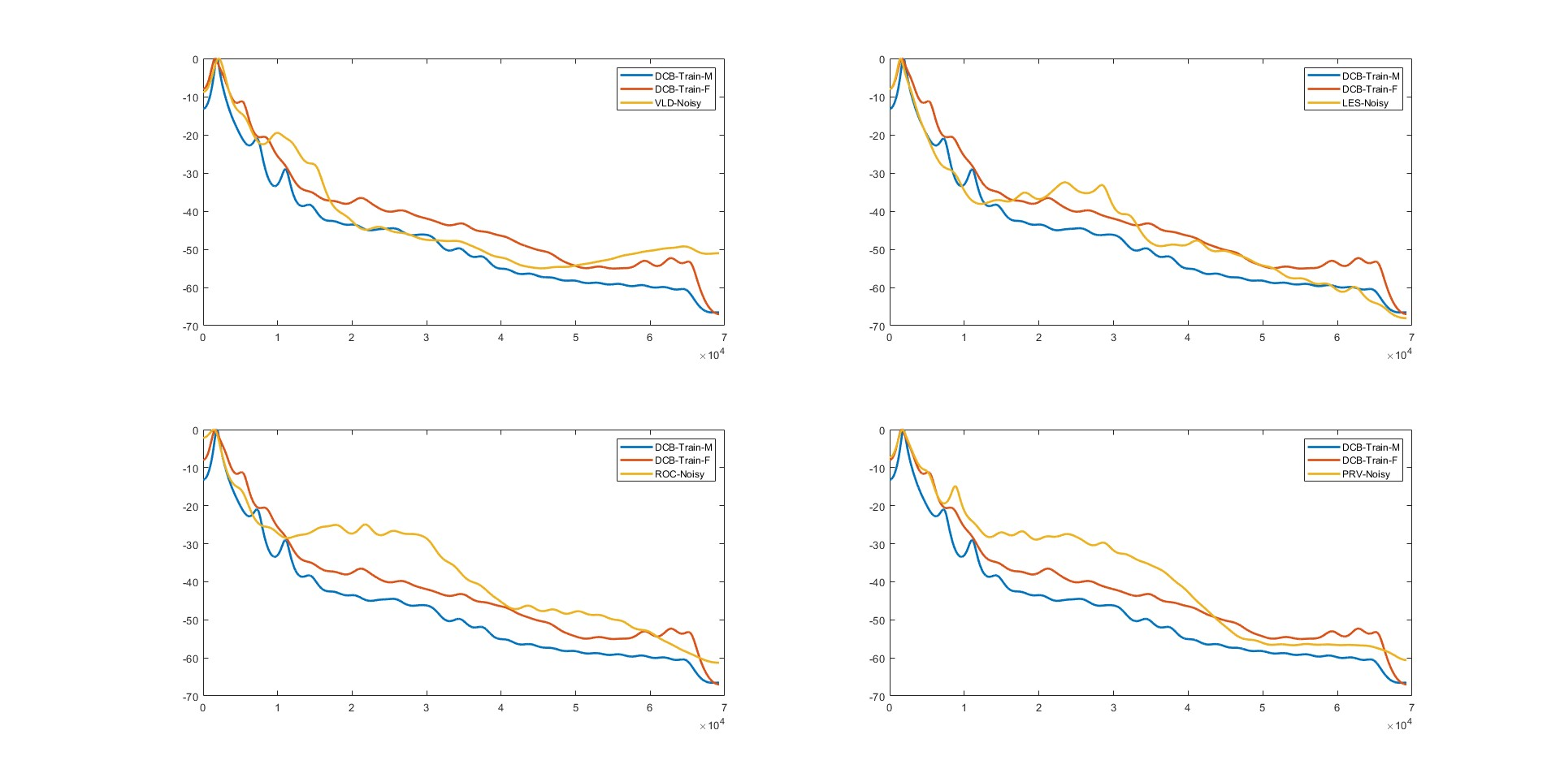

Slide 16
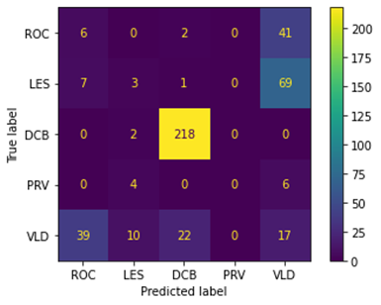
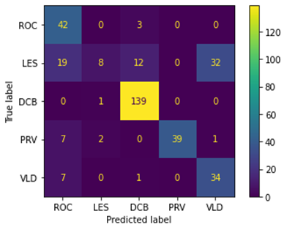
Feature Set 2 - LPC
Confusion Matrix
Clean
Noisy

Slide 17
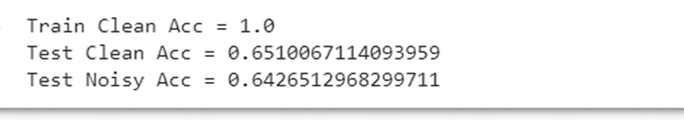
More Feature - PNCC
Pros:
Noise Robust
power-law nonlinearity instead of the MFCC log nonlinearity
Gammatone Filter Bank Instead of Mel Filter bank
Asymmetric filtering for noise suppression
Con:
Lack of Speaker Information

Slide 18
Even more features
Prosody:
Pitch Contour
Voiced&Unvoiced Segments Energy
Phonation:
1st&2nd order Derivatives of F0
Jitter and Shimmer

Slide 19
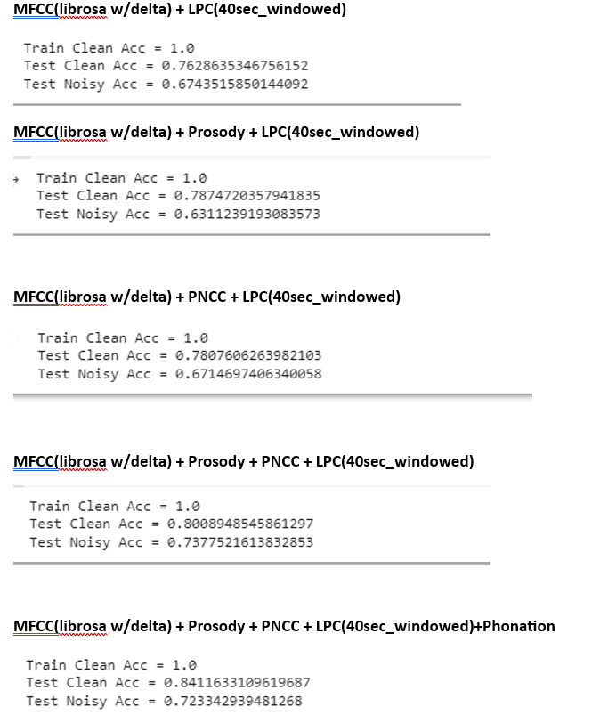

Slide 20
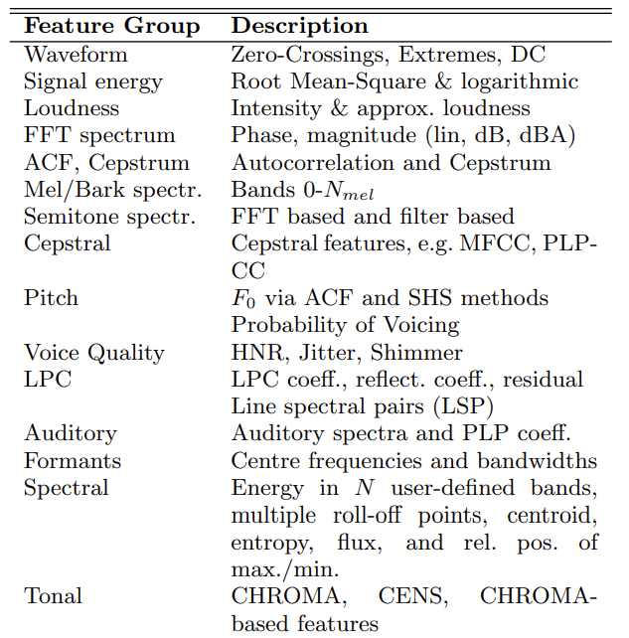
ComParE16 features
We used openSMILE toolkit to extract ComParE16 low level descriptors (LLDs) （65）
LLD includes some common features we have learned (Pitch, Autocorrelation, Cepstrum, MFCC).
openSMILE also has functional level features include 6373 features

Slide 21
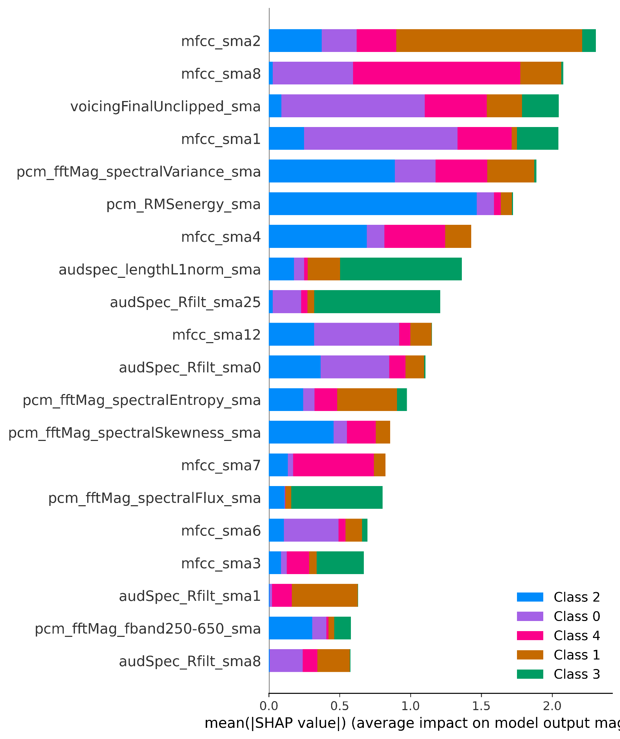
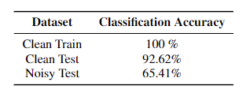
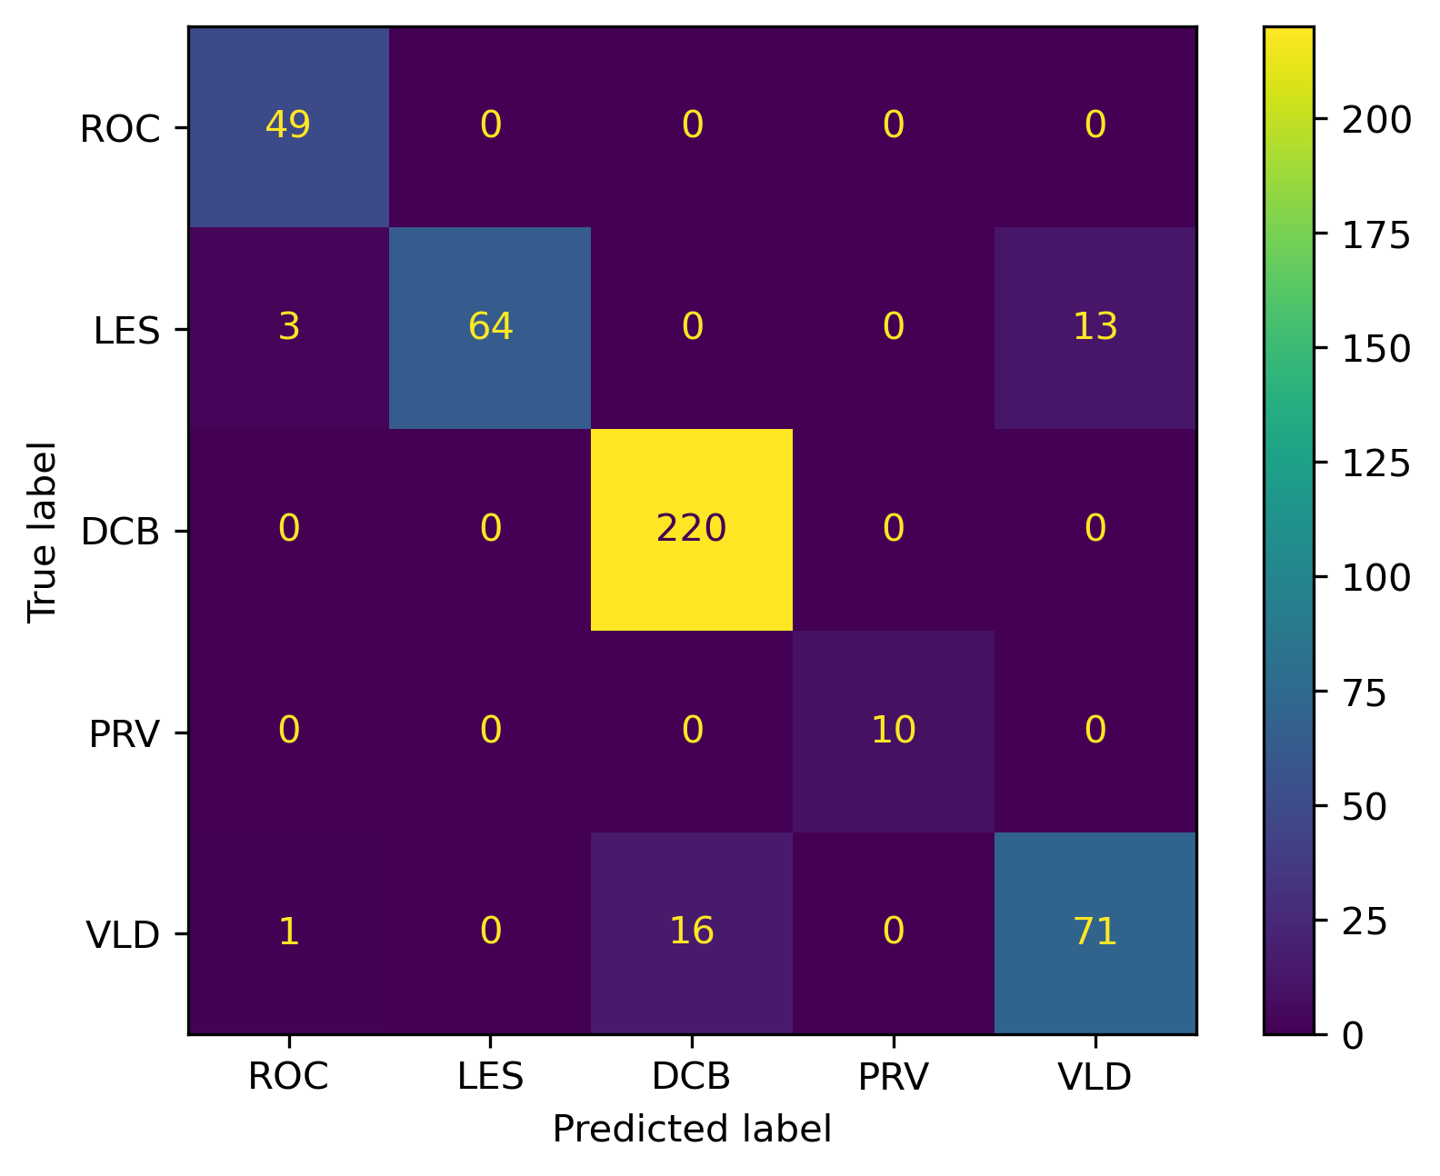
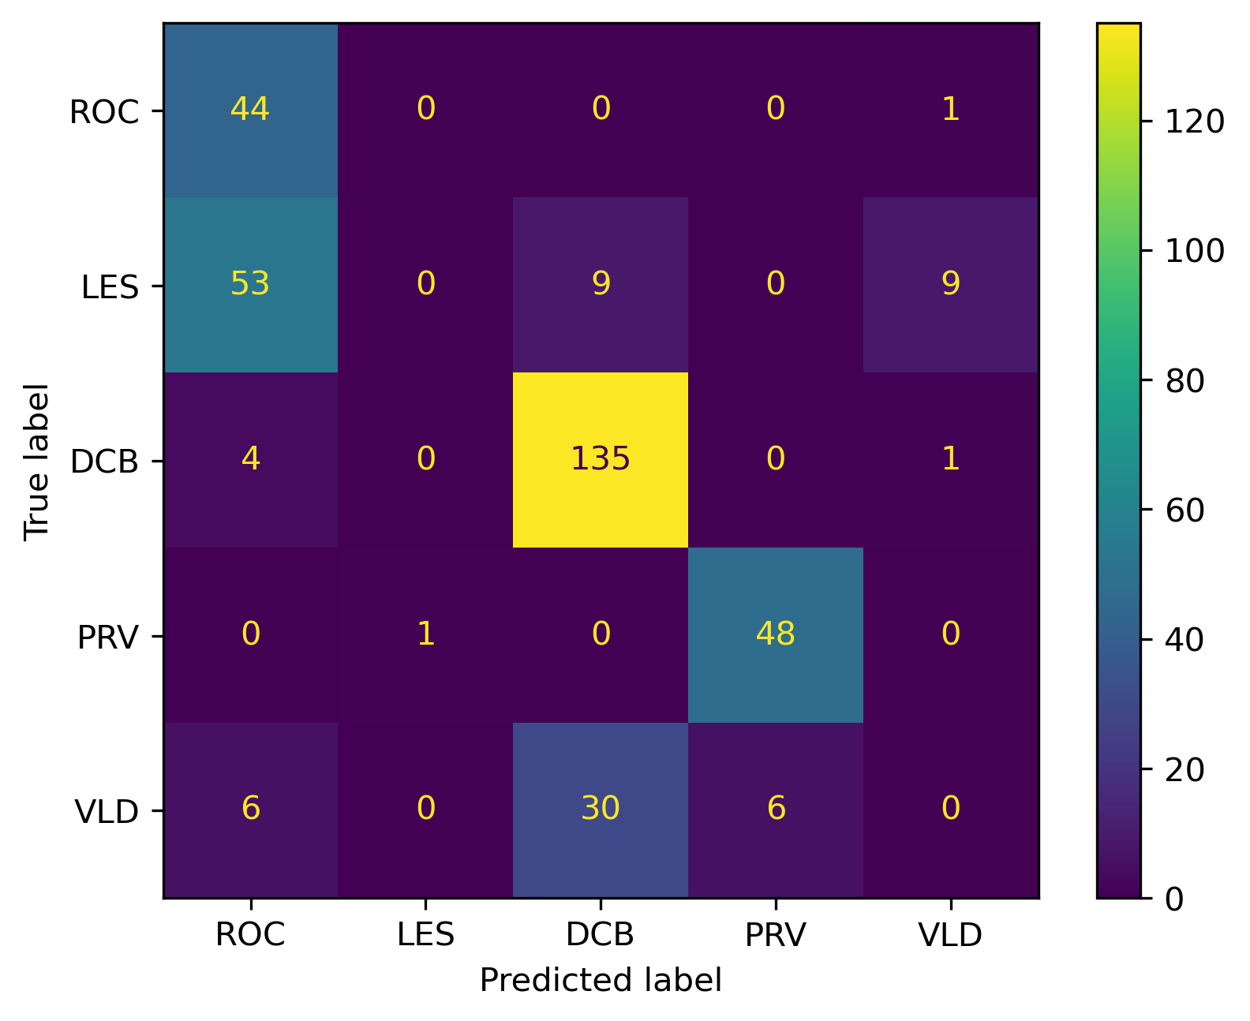
ComParE16 features
Test clean
Test noise
Notes:
pcm_fftMag: the magnitude of the fast Fourier transform (FFT) of a pulse-code modulation (PCM) signal. PCM is a method of encoding audio samples as digital values.
Pulse code modulation (PCM) is a method of converting an analog signal into a digital form. It involves sampling the analog signal at regular intervals and quantizing the samples into discrete values that can be represented by binary codes.
VoicingFinalUnclipped: the proportion of voiced frames at the end of an utterance that are not clipped. Clipping is a distortion that occurs when an audio signal exceeds the maximum amplitude that can be reproduced by a device. voicing final unclipped may be used to measure the quality or pathology of speech.
Audspec_Rfilt_sma spectral energy distribution of a signal after applying a filter bank and smoothing. The rfilt part indicates that the filter bank is based on an auditory frequency scale. The sma part indicates that the feature is calculated on short-term frames

Slide 22
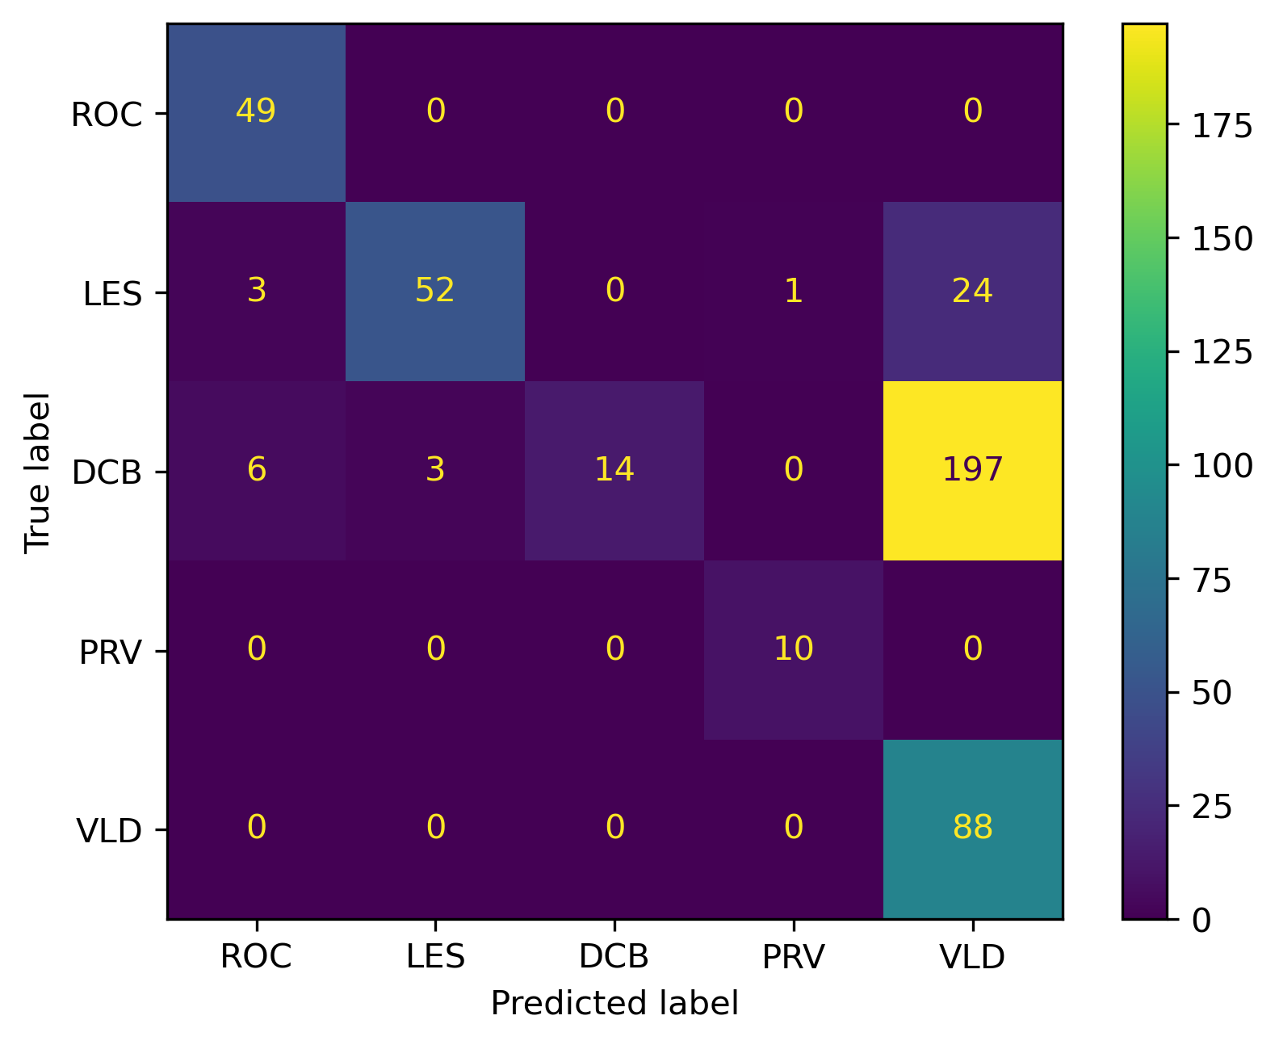
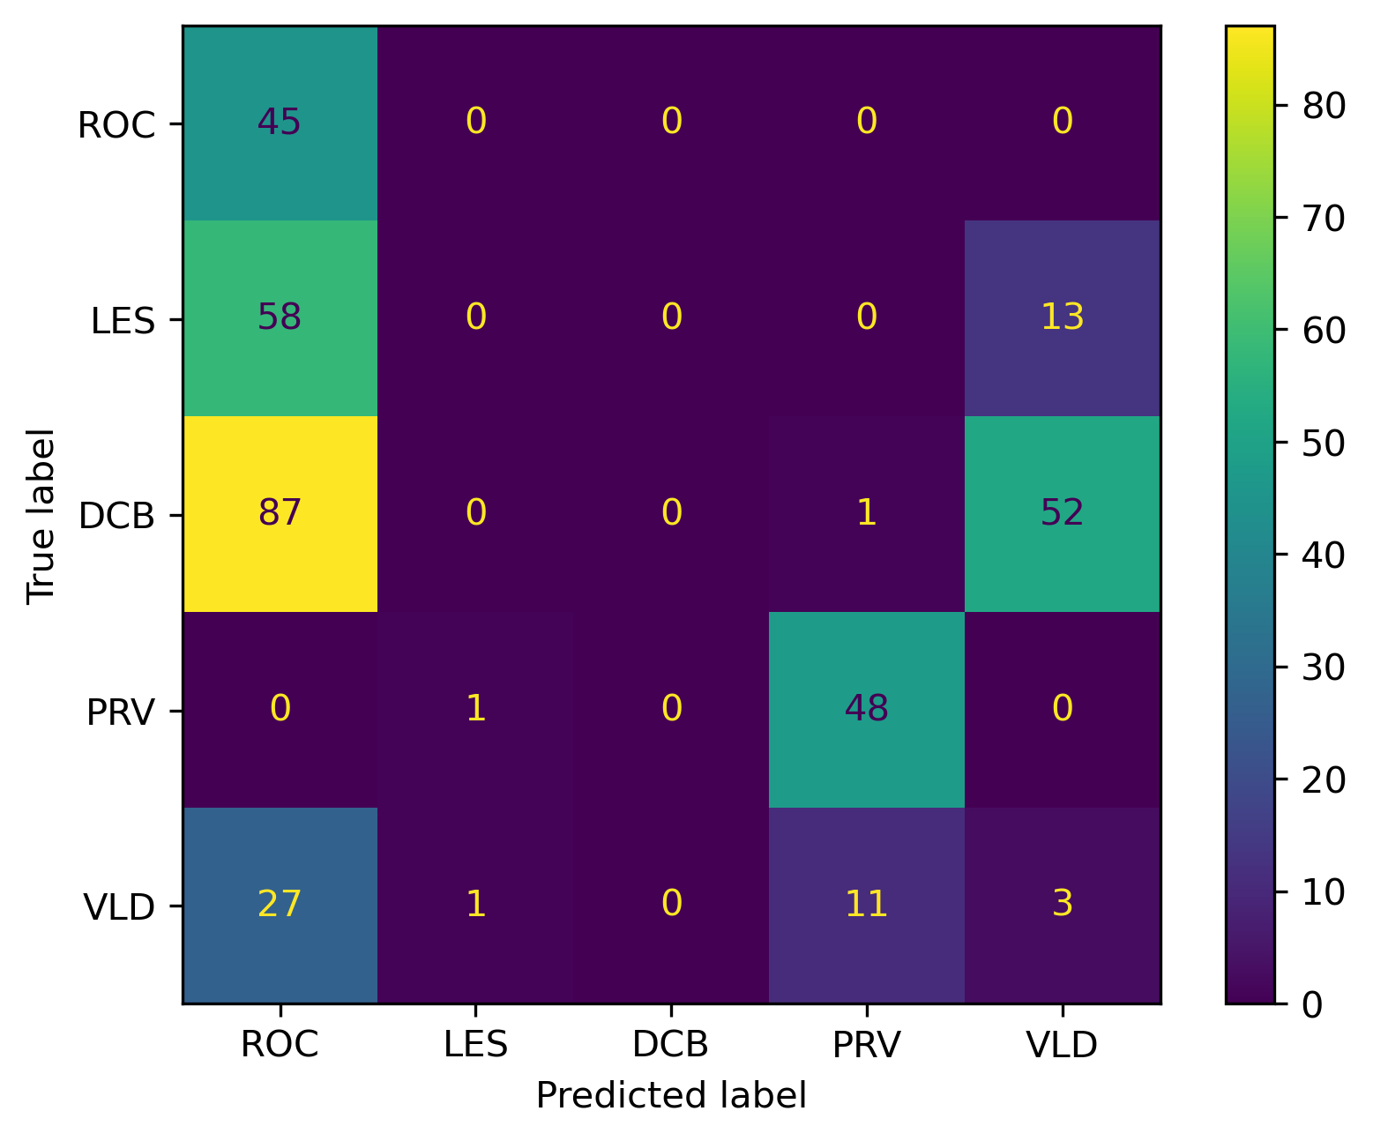
ComParE16 features
Test clean
Test noise
Original dataset
Remove 2300 DCB samples
Notes:
pcm_fftMag: the magnitude of the fast Fourier transform (FFT) of a pulse-code modulation (PCM) signal. PCM is a method of encoding audio samples as digital values.
Pulse code modulation (PCM) is a method of converting an analog signal into a digital form. It involves sampling the analog signal at regular intervals and quantizing the samples into discrete values that can be represented by binary codes.
VoicingFinalUnclipped: the proportion of voiced frames at the end of an utterance that are not clipped. Clipping is a distortion that occurs when an audio signal exceeds the maximum amplitude that can be reproduced by a device. voicing final unclipped may be used to measure the quality or pathology of speech.
Audspec_Rfilt_sma spectral energy distribution of a signal after applying a filter bank and smoothing. The rfilt part indicates that the filter bank is based on an auditory frequency scale. The sma part indicates that the feature is calculated on short-term frames

Slide 23
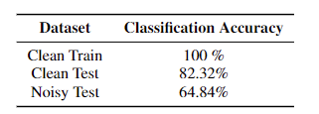
Attempts to improve the performance on noisy set
Concatenate ComParE16 features with MFCC features (×)
Apply denoise algorithms
noisereduce package
Only on noisy test set (×)
On all sets (clean train, clean test, noisy test) (×)
Audio-Denoising package
Only on noisy test set (×)
Add noise to the train set
MUSAN and RIRs noise dataset (×)
Custom method to prove the effectiveness of adding noise samples (√)

Slide 24
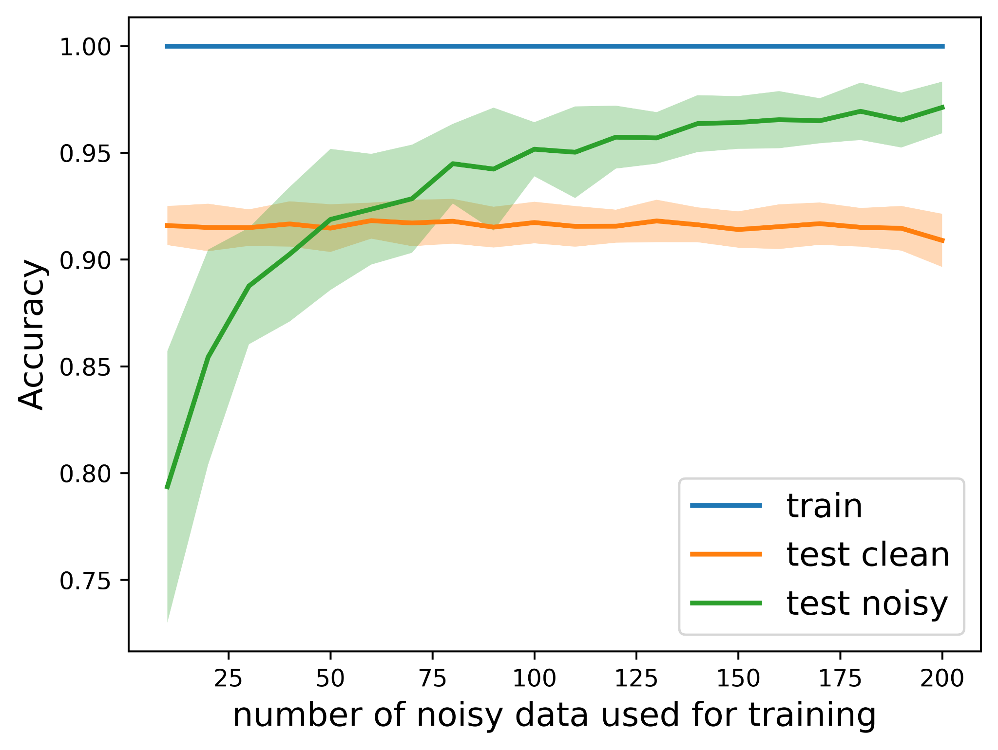
Attempts to improve the performance on noisy set
Randomly selected a certain number of noisy samples from noisy test data set .
Test on (train clean + train noisy), (test clean), (test noisy excludes samples used for training)
For each extraction number, repeated 20 times to get average and standard deviation.
Noisy samples help a lot
Classifier has enough capacity to learn from the noisy dataset but need supervision.

Slide 25
Best Model Results
Speech knowledge + machine learning knowledge
Features (289 in total):
librosa MFCC (39, include 1st and 2nd derivative), torchaudio MFCC (13), PNCC (13), LPC_40s_window (49), Prosody (103), Phonation (7), and ComParE16 (65)
Tricks:
We noticed the order of the features matters and the final accuracy fluctuates by 3%.
We shuffled the input features order before train the classifier and repeated for 40 times.
Notes:
mel frequency cepstral coefficients,Power-Normalized Cepstral Coefficients

Slide 26
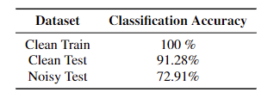
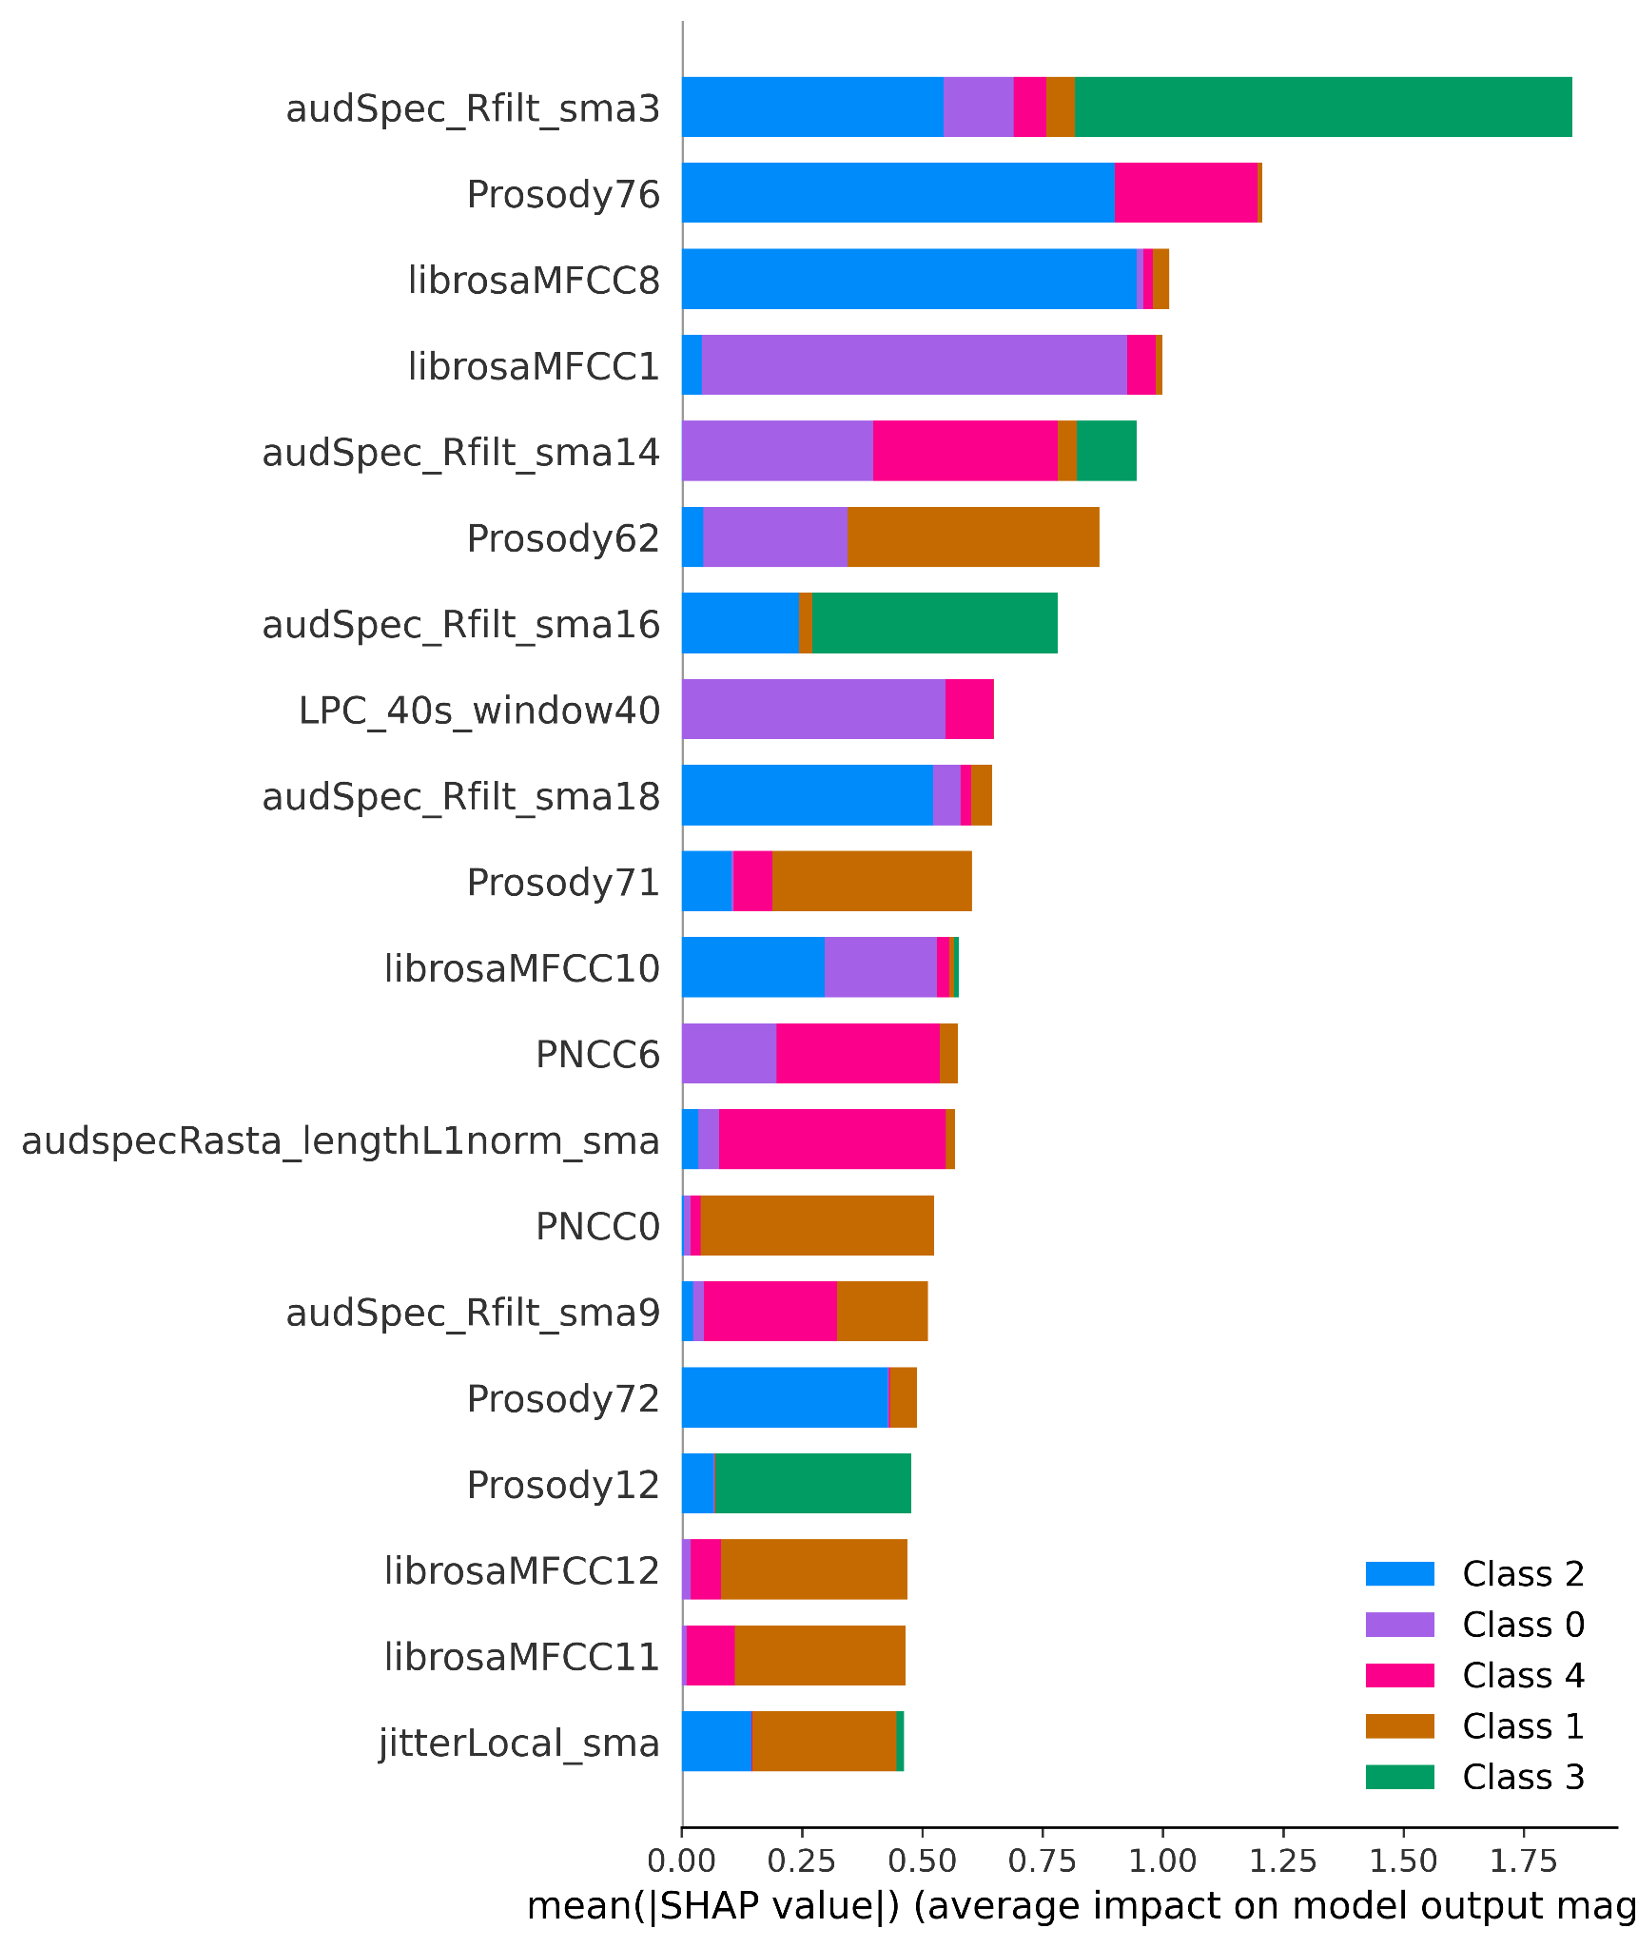
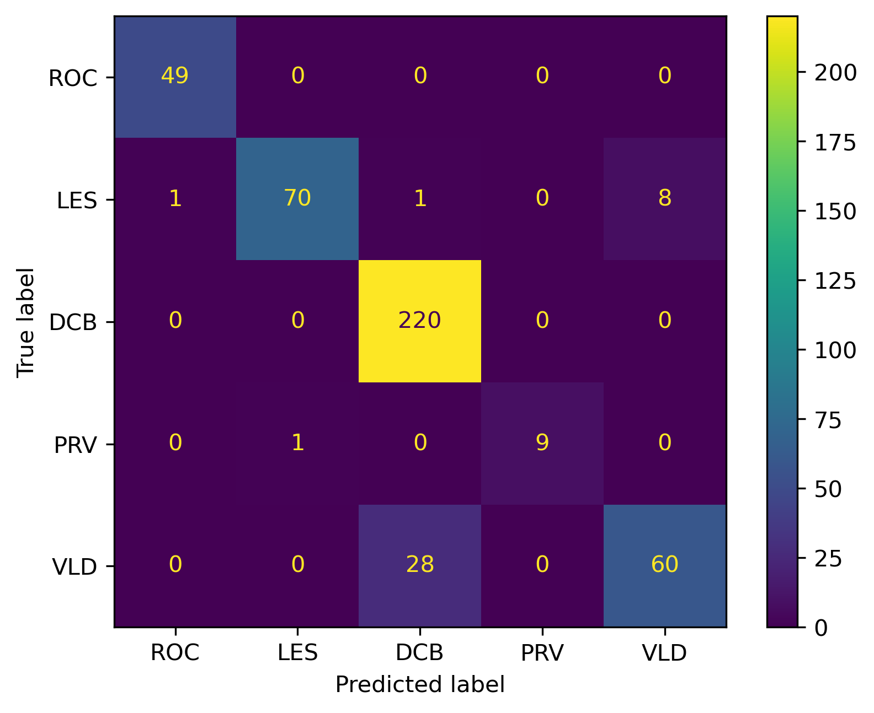
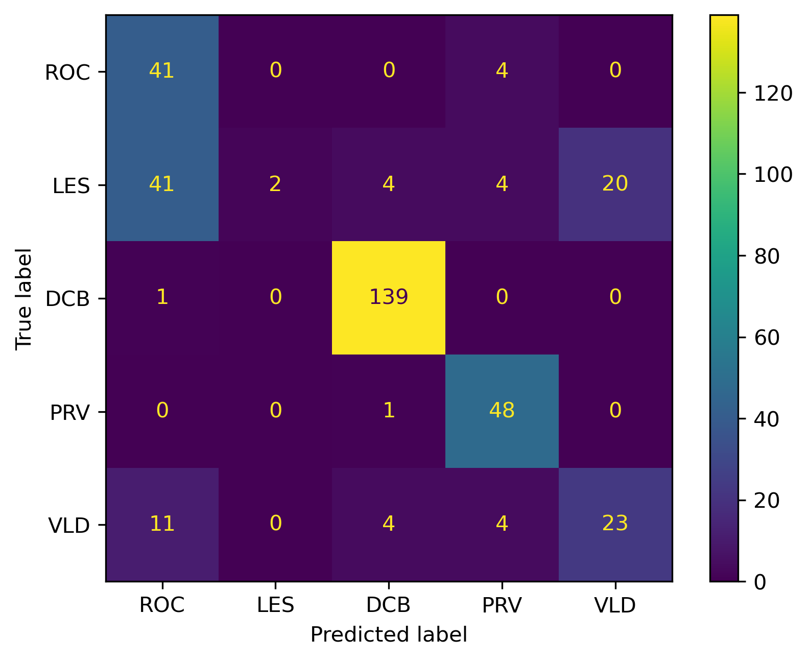
Best Model Results
Test Clean
Test Noisy
The improvement on noisy test set is mostly from the correction of the VLD accents
Notes:
Audspec_Rfilt_sma spectral energy distribution of a signal after applying a filter bank and smoothing. The rfilt part indicates that the filter bank is based on an auditory frequency scale. The sma part indicates that the feature is calculated on short-term frames3

Slide 27
Reference
Snyder, David, et al. "X-vectors: Robust dnn embeddings for speaker recognition." 2018 IEEE international conference on acoustics, speech and signal processing (ICASSP). IEEE, 2018.
Johnson, Alexander, et al. "Automatic Dialect Density Estimation for African American English." arXiv preprint arXiv:2204.00967 (2022).
C. Kim and R. M. Stern, "Power-Normalized Cepstral Coefficients (PNCC) for Robust Speech Recognition," in IEEE/ACM Transactions on Audio, Speech, and Language Processing, vol. 24, no. 7, pp. 1315-1329, July 2016, doi: 10.1109/TASLP.2016.2545928.

